Slide 1
NAMES AND ID
Mina Eid Zakaria 2101114
kerolos ayman gamal 2100870
Kerolos wise Abd altawab 2100869
Makar maged bartey 2100951
MINA MAHROUSE LAHZY 2101110
JOHN AYMAN KAMEL 2100823

Slide 2
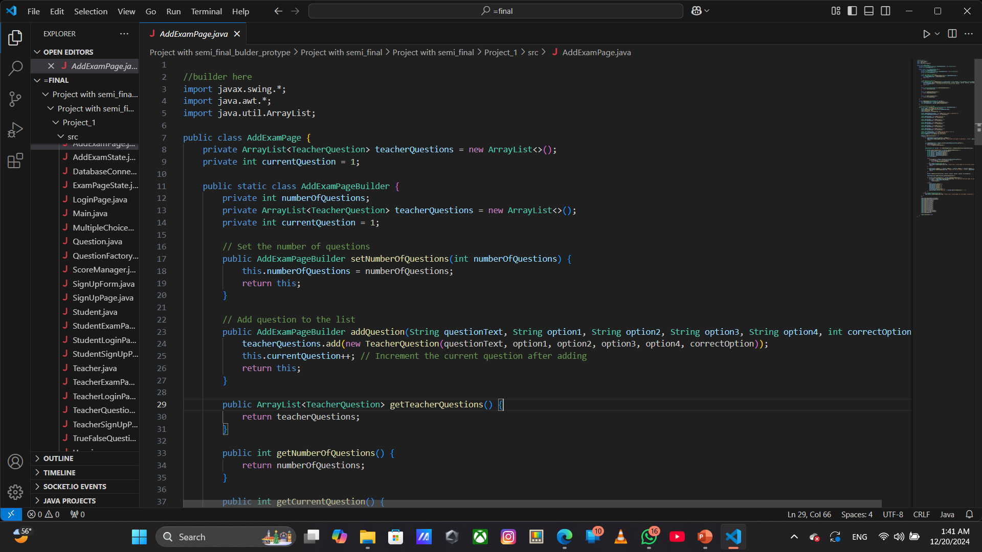
Builder Pattern Implementation:
The AddExamPageBuilder inner class allows for the step-by-step creation of an AddExamPage object.
It allows setting the number of questions and adding individual questions with options and the correct answer.
The builder pattern makes it easier to construct complex objects incrementally.
User Interface for Adding Exams:
The display() method creates a GUI form where teachers can input the number of questions and details for each question.
The form includes fields for question text, four answer options, and the correct answer.
There is a button to add questions one by one until the specified number of questions is reached.
Validation and Error Handling:
The system ensures that the user provides a valid number of questions.
It checks that each question, options, and correct answer are entered before adding it.
If an error occurs (like invalid input), it shows a popup message to the user.
Question Tracking:
The current question number is tracked so the user knows how many questions are left to input.
After all questions are added, the user is prompted to confirm if they want to close the window.
Data Storage:
All questions entered by the user are stored in an ArrayList of TeacherQuestion objects.
The list can be accessed to retrieve the questions for further processing or storage in a database.

Slide 3
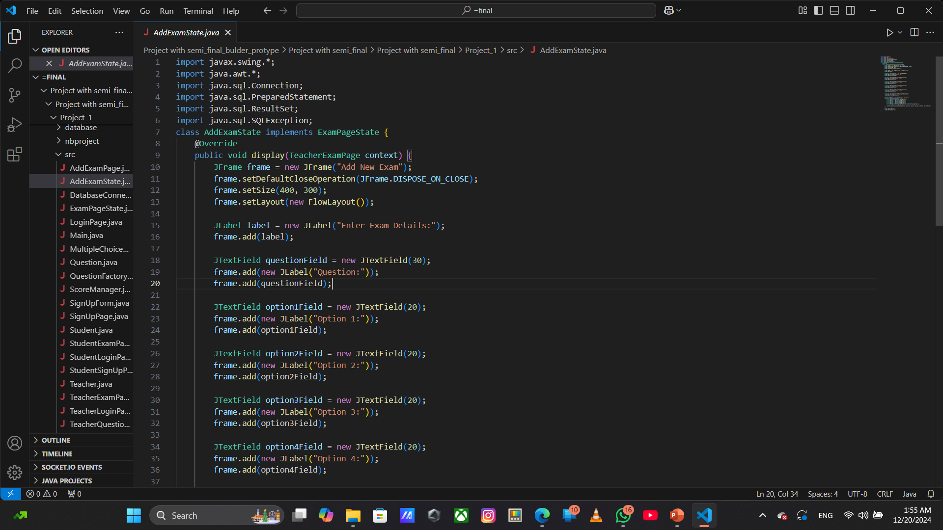
State Design Pattern:
This class implements the State Pattern by conforming to the ExamPageState interface.
It defines the behavior for the "Add Exam" state of the TeacherExamPage.
User Interface for Adding Questions:
The display() method creates a GUI form that allows the teacher to enter a new question and its options (Option 1, Option 2, Option 3, Option 4) along with the correct option (1-4).
The GUI form uses JTextFields for inputs and a JButton to trigger the action of saving the question.
Saving Questions to the Database:
When the "Save Question" button is clicked, the input fields are read, and the provided data (question, options, and correct option) are sent to the TeacherExamPage using context.addQuestionToDatabase().
This method connects to the database and inserts the question into a questions table.
Data Validation and Error Handling:
The program assumes that the user inputs a valid number (1-4) for the correct option.
There is no explicit validation for empty fields, but errors could be thrown if inputs are missing or incorrect.
Dynamic Behavior with State Changes:
By using the State Pattern, the behavior of the TeacherExamPage can change depending on its current state.
This allows for a flexible and extensible design where more states can be added without modifying the core logic of TeacherExamPage.

Slide 4
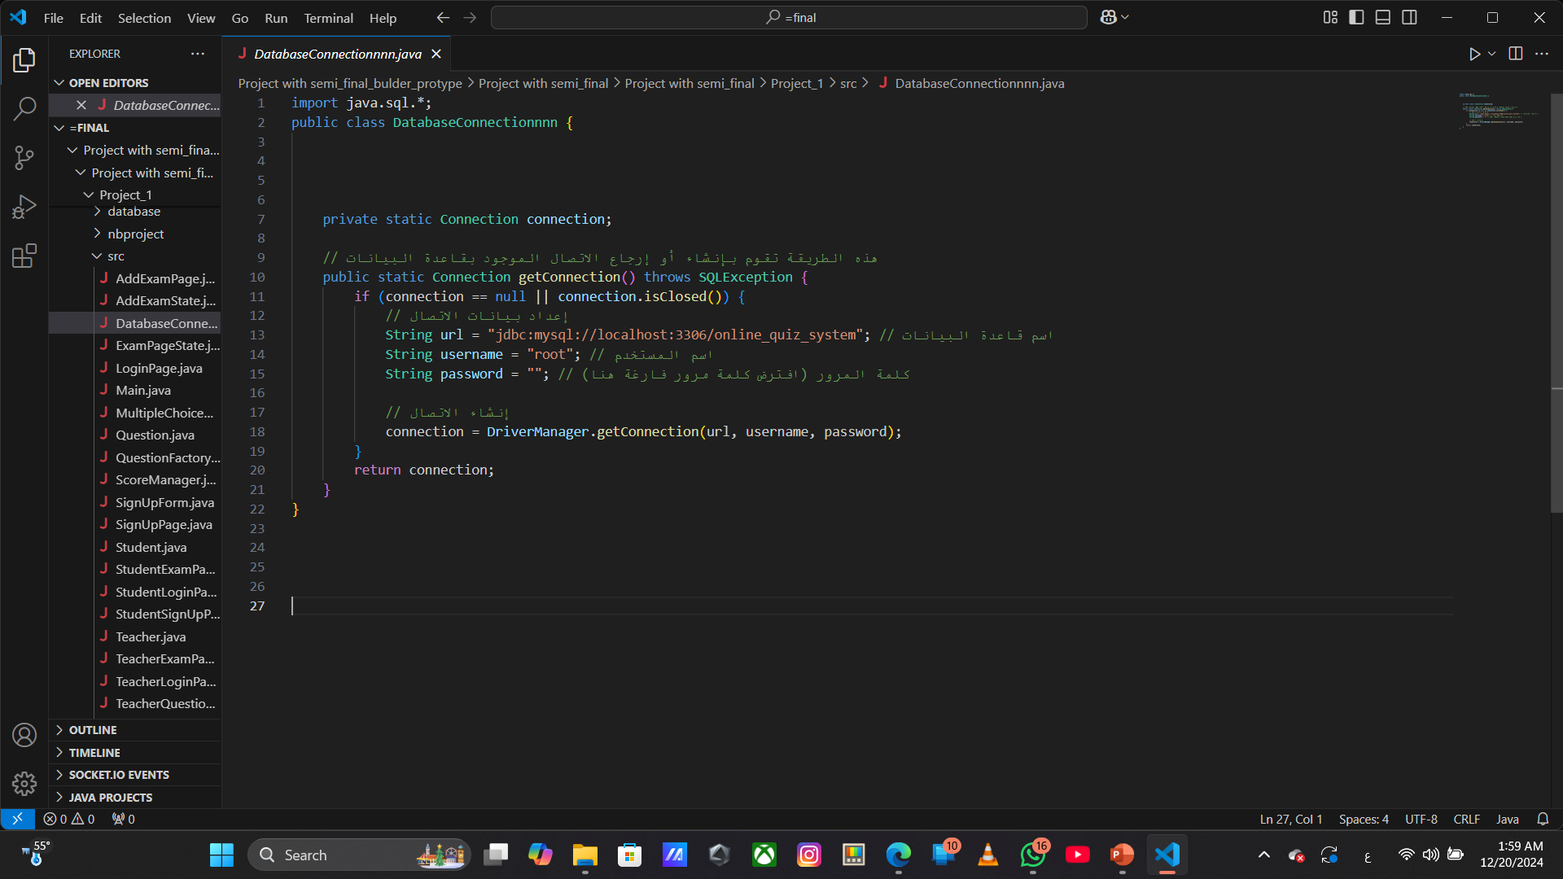
Single Connection: It ensures only one connection to the MySQL database is active at a time (Singleton Pattern).
Connection Setup: Connects to the online_quiz_system database using a URL, username, and password.
Reusability: Reuses the connection if it's already open, reducing reconnection time.
Error Handling: Handles SQL exceptions if the connection fails.

Slide 5
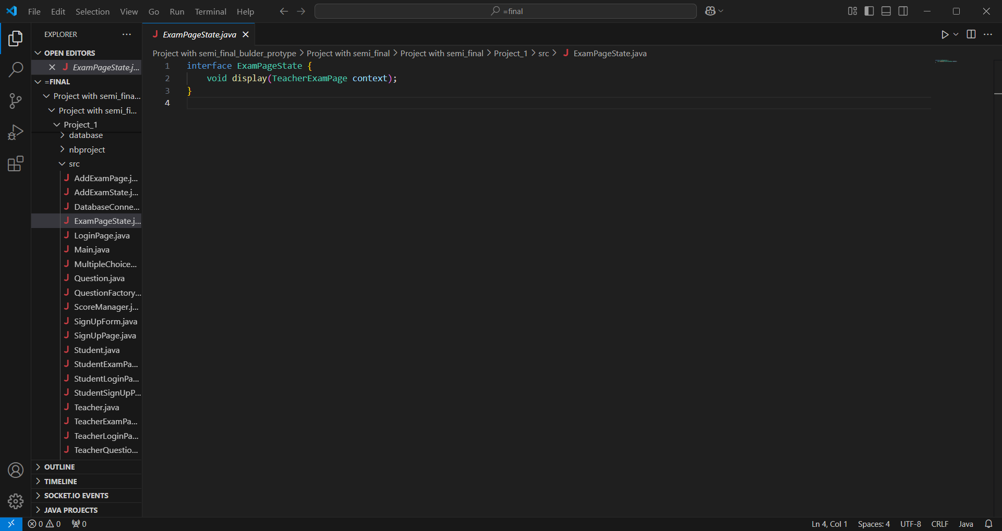
Interface Name: ExamPageState
Method: void display(TeacherExamPage context);
Purpose:
Defines a contract for classes that manage different states of the TeacherExamPage.
Any class implementing this interface must define the display method.
The method accepts a TeacherExamPage object as a parameter.
Pattern: Likely part of the State Design Pattern, managing various states of the

Slide 6
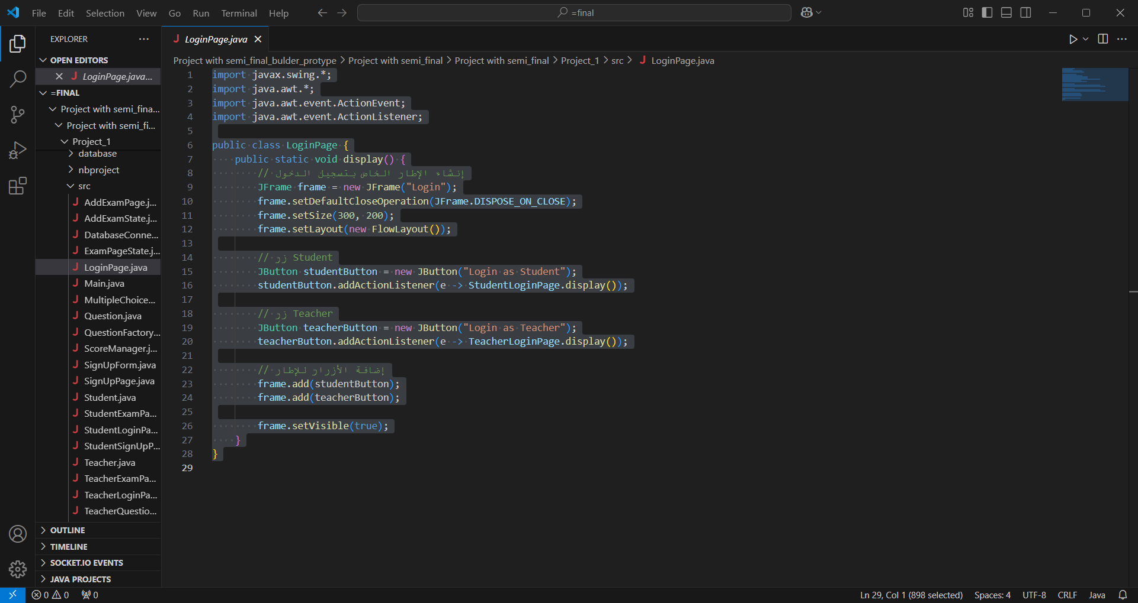
This class, LoginPage, is responsible for creating and displaying a login window with two buttons.
It creates a JFrame titled "Login" with a simple layout.
Two buttons are added:
"Login as Student": Opens the StudentLoginPage when clicked.
"Login as Teacher": Opens the TeacherLoginPage when clicked.
The frame is set to be visible, allowing users to choose whether to log in as a student or a teacher.

Slide 7
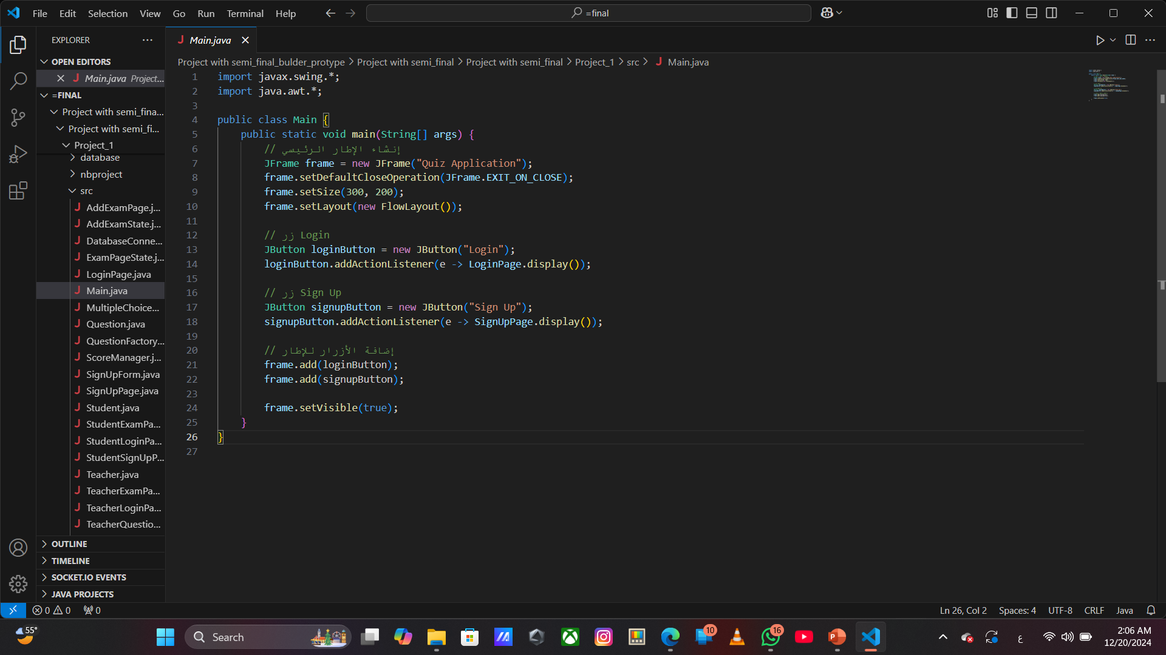
This class, Main, serves as the entry point for the application.
It creates the main JFrame window titled "Quiz Application."
Two buttons are added:
"Login": When clicked, it opens the LoginPage.
"Sign Up": When clicked, it opens the SignUpPage.
The frame is set to be visible, allowing users to either log in or sign up to the application.

Slide 8
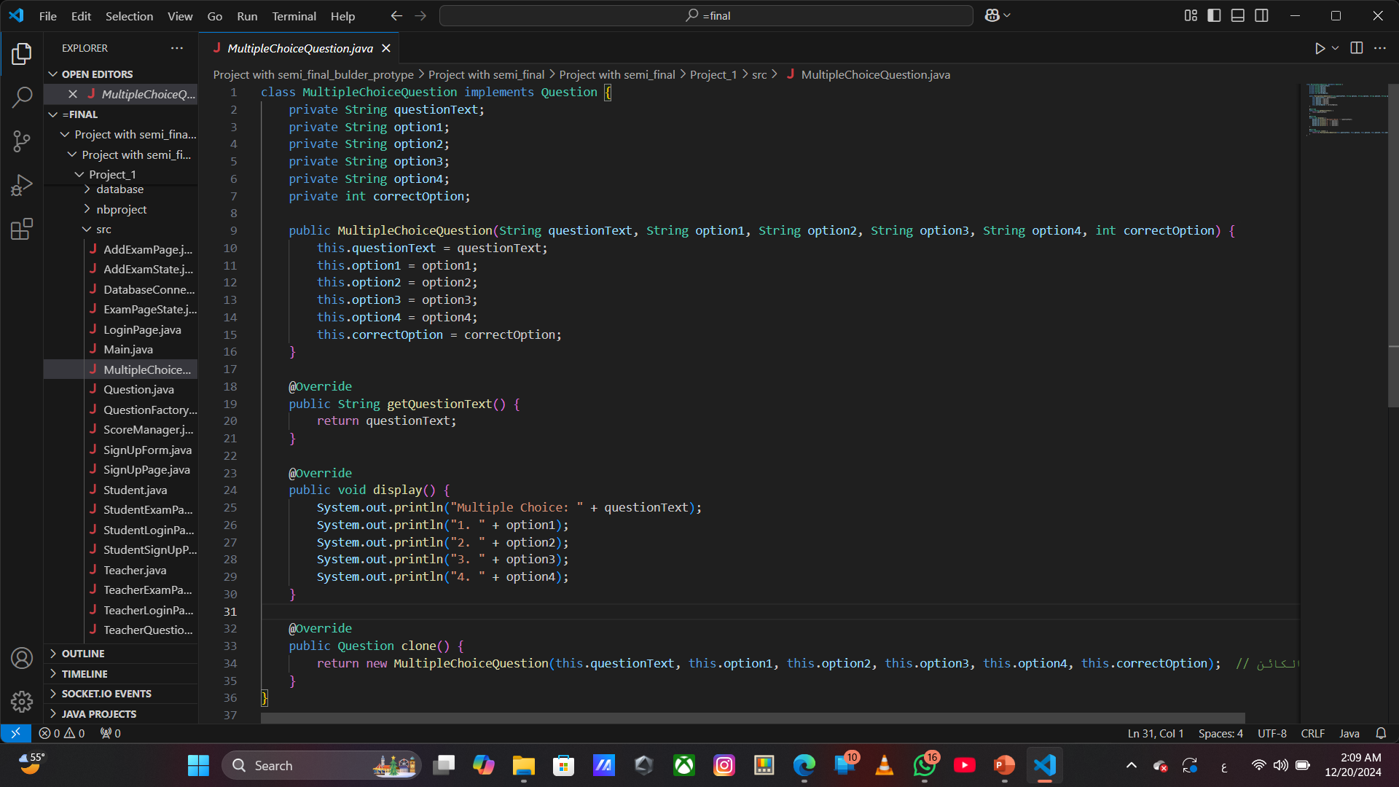
This class, MultipleChoiceQuestion, implements the Question interface and represents a multiple-choice question.
Key Features:
Attributes:
questionText: The text of the question.
option1, option2, option3, option4: The four options available for the multiple-choice question.
correctOption: The index of the correct answer (1 to 4).
Constructor:
Initializes the MultipleChoiceQuestion with the question text, four options, and the index of the correct option.
Methods:
getQuestionText(): Returns the question text.
display(): Prints the question and options to the console.
clone(): Creates and returns a new copy (clone) of the current MultipleChoiceQuestion object.
This class provides the structure for handling multiple-choice questions, including displaying the options and cloning the question for reusability.

Slide 9
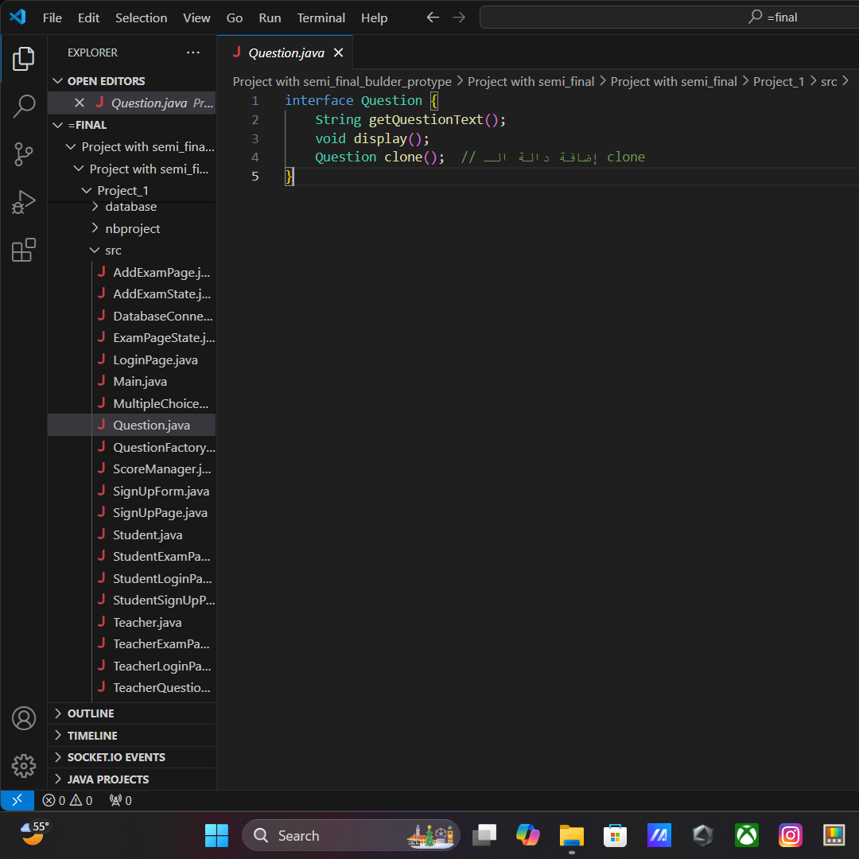
The Question interface defines three methods:
getQuestionText(): Returns the question text.
display(): Displays the question and its options.
clone(): Creates a copy of the question.
Any class implementing this interface must provide implementations for these methods.

Slide 10
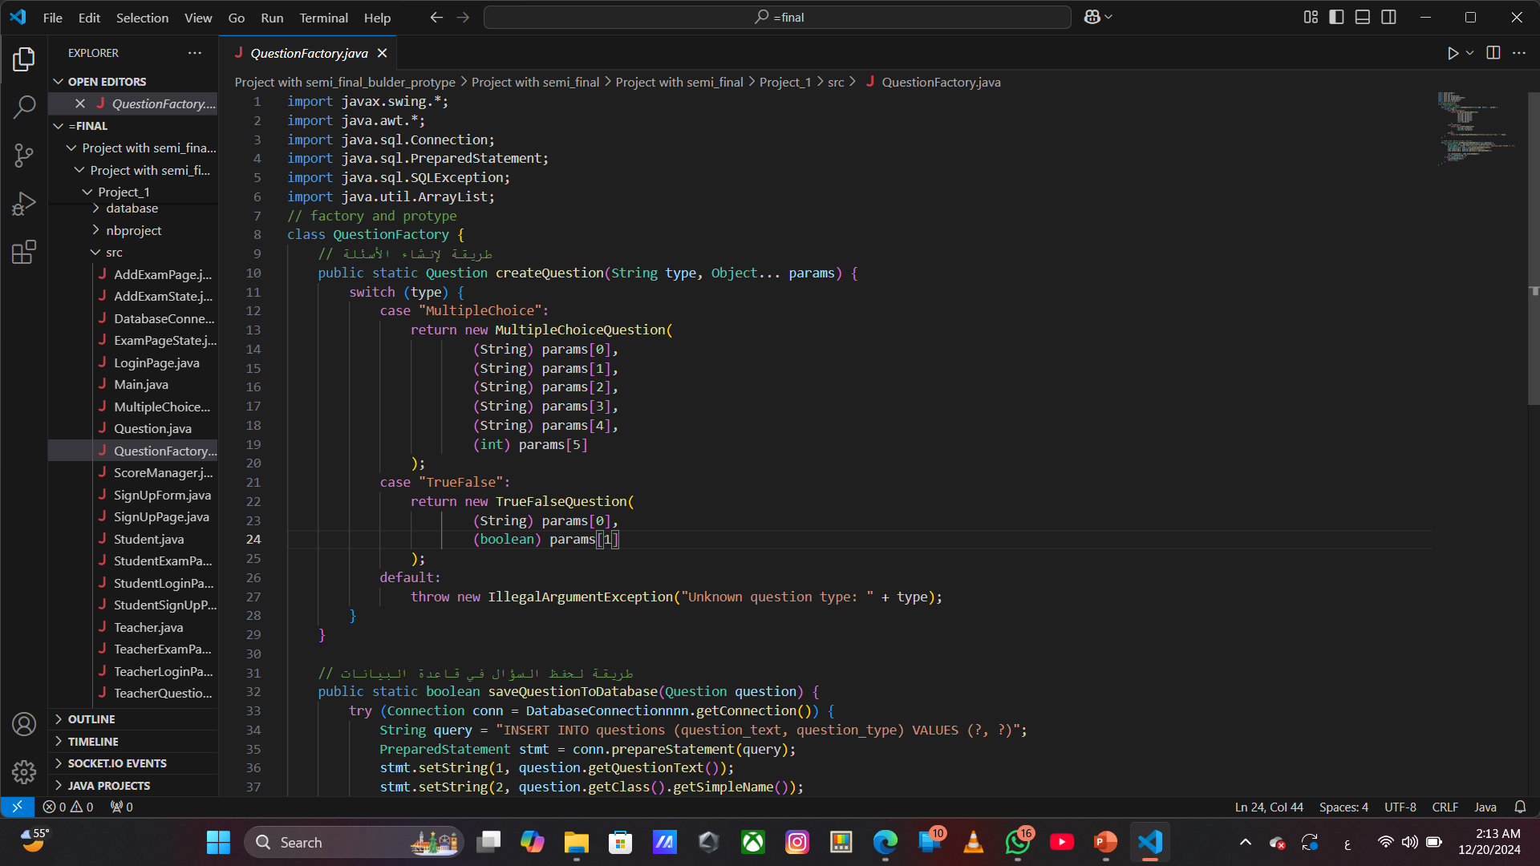
The QuestionFactory class implements two key functionalities:
createQuestion():
A factory method that creates and returns different types of questions (MultipleChoiceQuestion, TrueFalseQuestion) based on the provided type and parameters.
It uses a switch statement to handle different question types.
saveQuestionToDatabase():
A method that saves a given Question object to a database.
It connects to a database, prepares an SQL query, and inserts the question text and type into the questions table.
This class utilizes the Factory design pattern for question creation and the Prototype pattern for cloning.

Slide 11
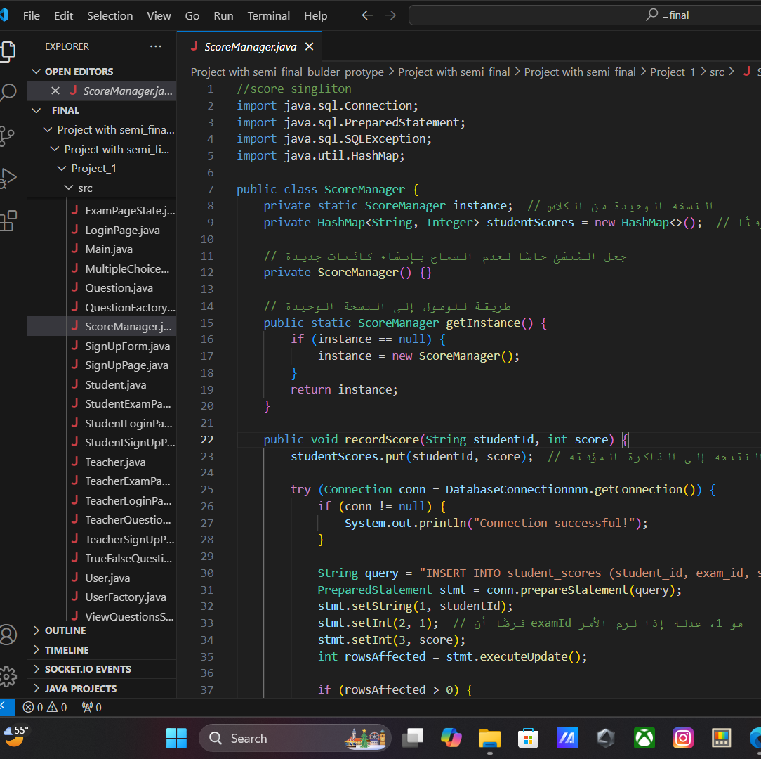
The ScoreManager class follows the Singleton pattern, ensuring only one instance exists. It manages student scores by:
Storing scores in a HashMap temporarily.
Inserting scores into the student_scores table in a database using JDBC in the recordScore() method.
The getInstance() method provides access to the single instance of the class.

Slide 12
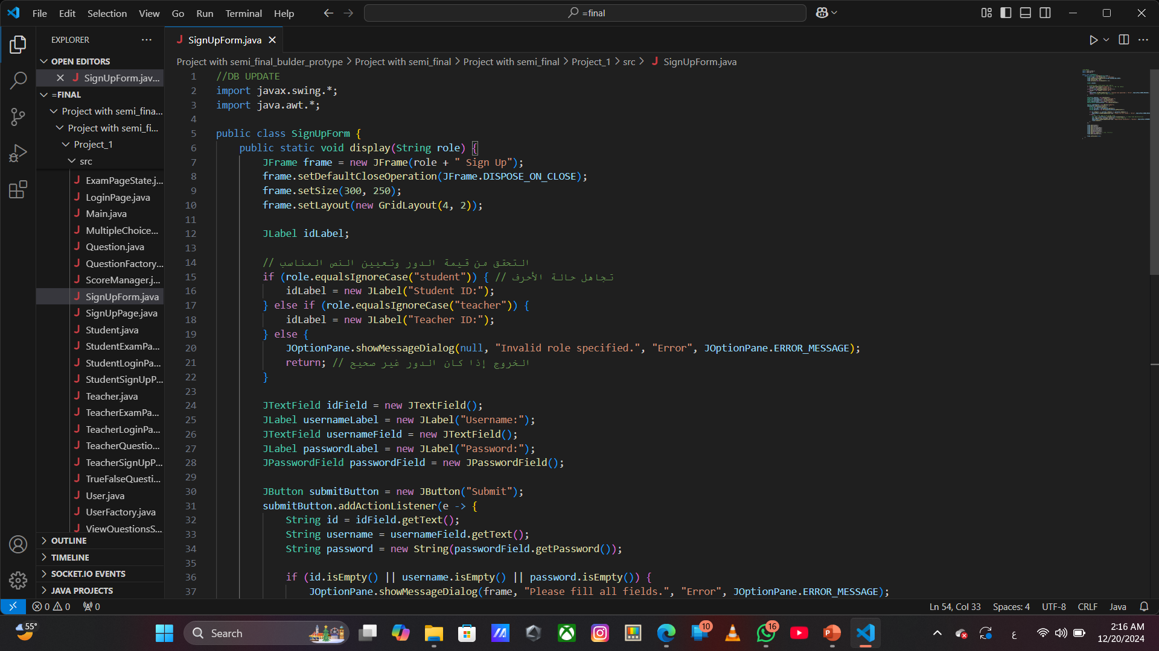
The SignUpForm class displays a dynamic sign-up form based on the role (student or teacher).
It includes fields for ID, username, and password.
On form submission, it validates the input and registers the user using the UserFactory.
Success or error messages are shown depending on the input or role validity.

Slide 13
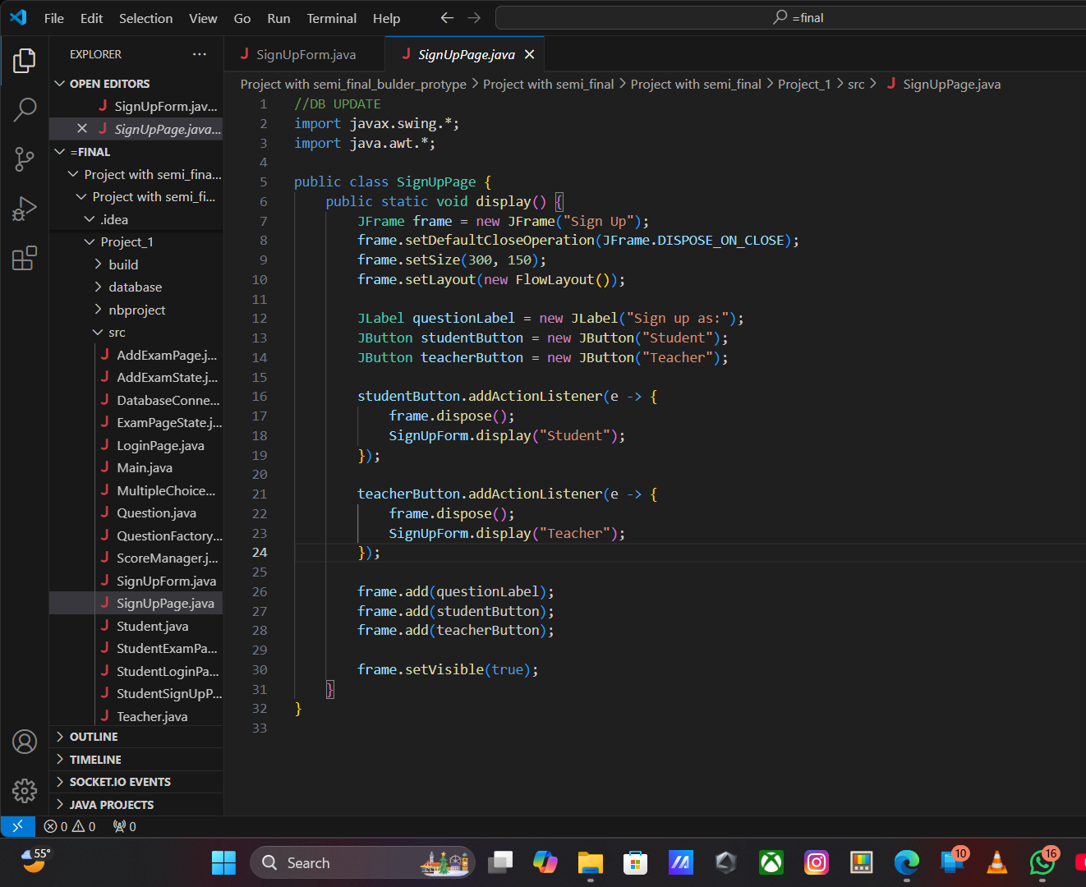
The SignUpPage class displays a page where users can choose to sign up as either a student or teacher.
Key Features:
Displays a prompt "Sign up as:" with two buttons: Student and Teacher.
Clicking on a button closes the current page and opens the corresponding sign-up form (SignUpForm) for the selected role.

Slide 14
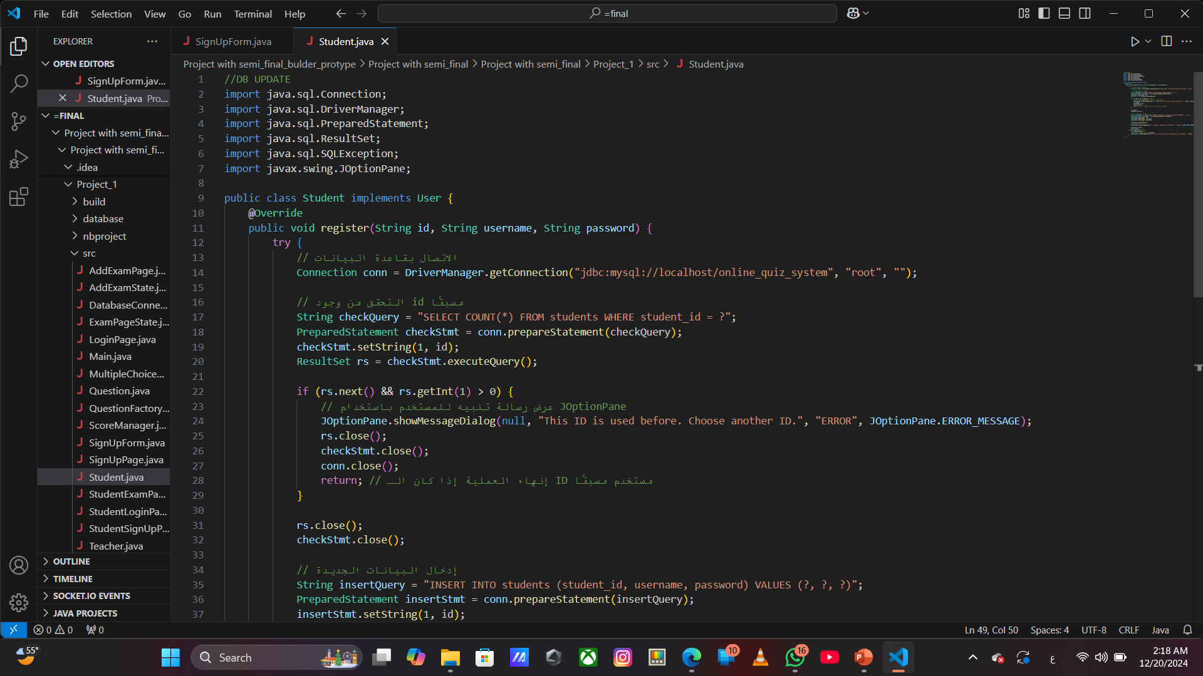
The Student class implements the User interface and is responsible for registering a student in the database.
Key Features:
Register Method:
It connects to a MySQL database (online_quiz_system) to register the student.
First, it checks if the student ID already exists in the students table. If the ID is taken, an error message is displayed.
If the ID is unique, it inserts the student's details (student_id, username, password) into the students table.
Error Handling:
If the ID is already used, a message is shown to inform the user.
If an error occurs while interacting with the database, an error message is shown.
This class ensures that student registration is handled efficiently and provides feedback to the user based on the success or failure of the registration process.

Slide 15
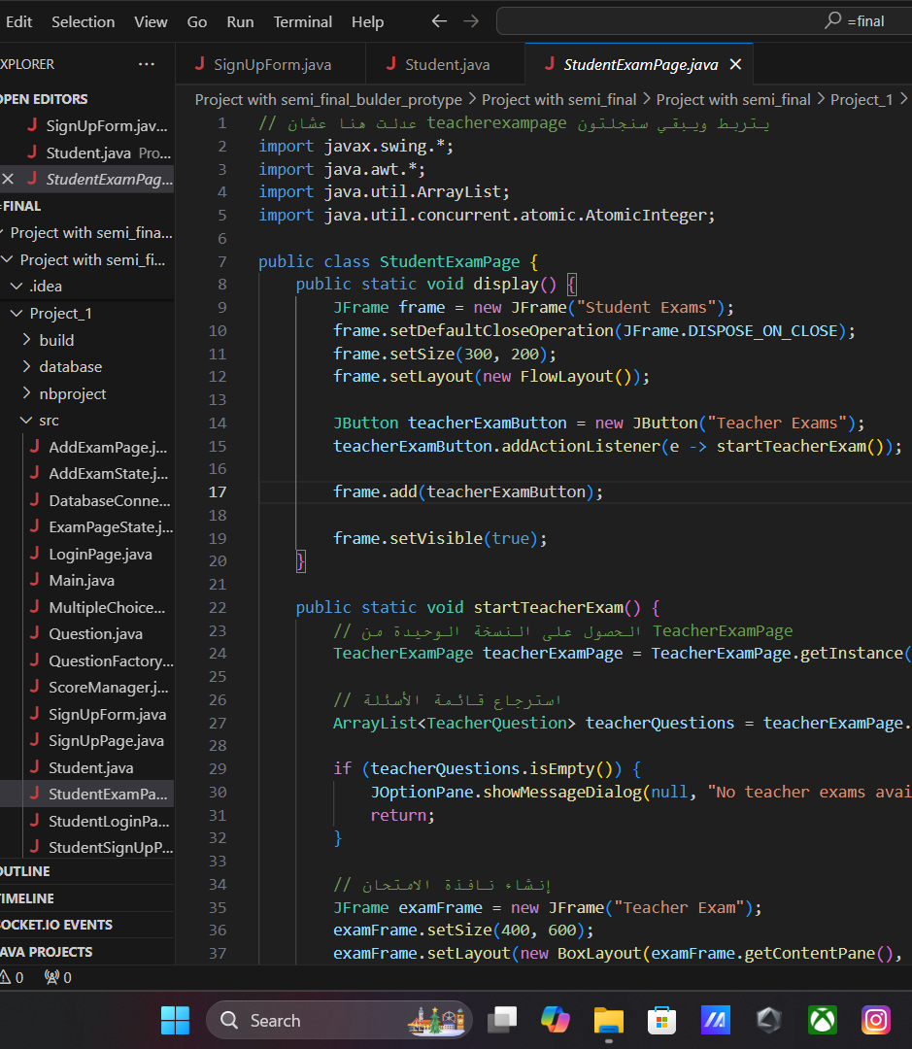
The StudentExamPage class allows students to access and take teacher exams.
Key Features:
Singleton Integration: Uses TeacherExamPage.getInstance() to access a single instance of teacher exam data.
Exam Navigation: Students view questions and navigate using the Next button.
Question Display: Questions are shown with multiple-choice options, ensuring only one choice is selected.
Scoring System: Tracks and displays the student’s score at the end.
Timer: Supports optional exam timing logic.

Slide 16
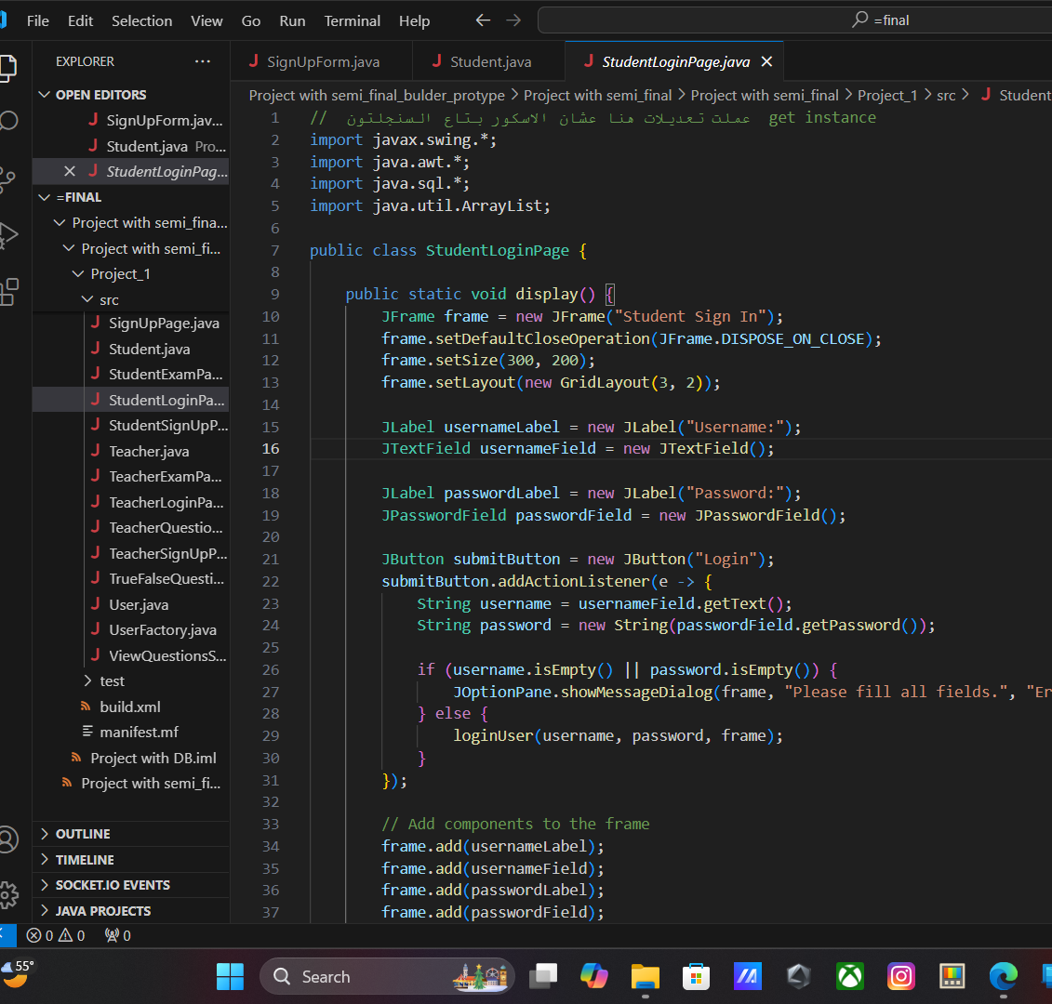
Login System
Exam Choice Page
Teacher's Exam Page
Submit Answers and Calculate Score
Tables Used in the Database

Slide 17
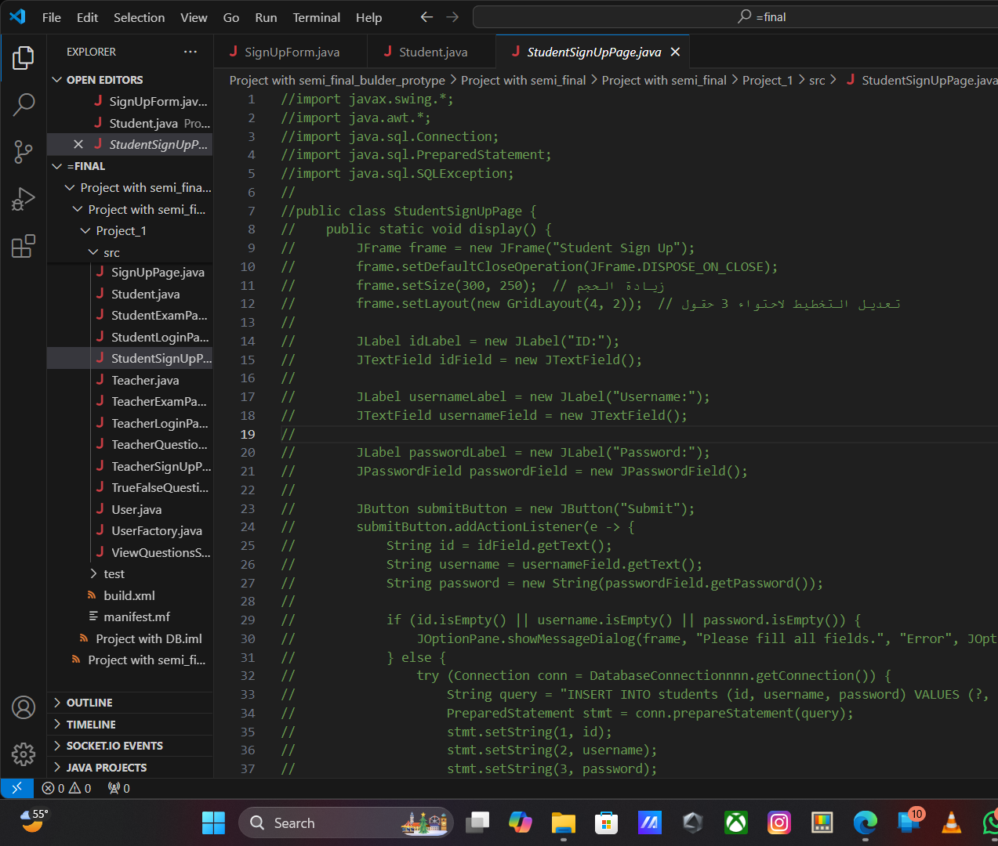
Here's a concise version of the StudentSignUpPage class:
UI Setup: Creates a JFrame with a GridLayout for fields: ID, Username, and Password.
Submit Button: On click, validates the fields. If valid, inserts the data into the database using a PreparedStatement.
Database Connection: The student's data is inserted into the students table. Success or error messages are displayed based on the operation.
Let me know if you need further details!

Slide 18
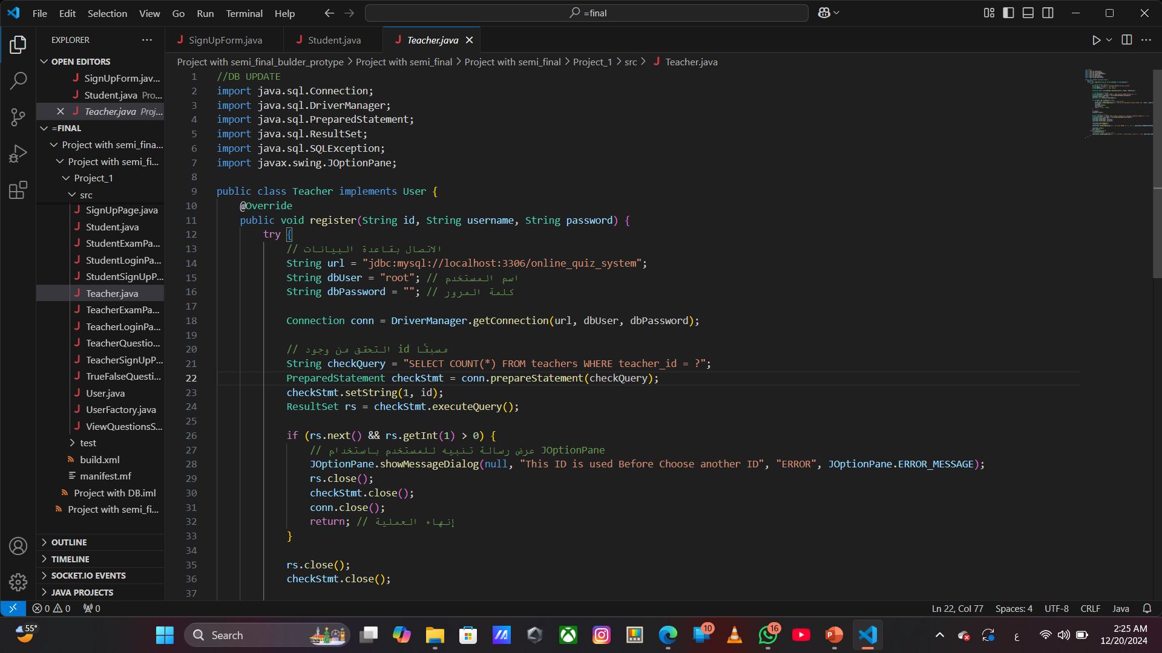
Here's a brief summary of your Teacher class:
Purpose: The class implements the User interface, specifically for teacher registration.
Database Operations:
Checks if the teacher's ID is already used in the teachers table. If it is, an error message is displayed.
If the ID is available, it inserts the teacher's information (ID, username, password) into the teachers table.
Error Handling: If a database error occurs, it prints the stack trace and shows an error message to the user.
This implementation ensures that each teacher has a unique ID and prevents duplicate entries in the database.

Slide 19
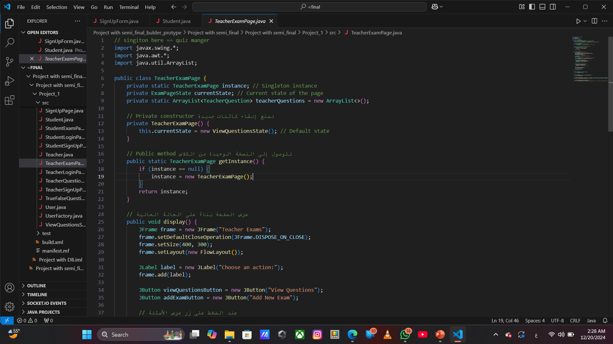
Singleton Pattern: This class uses the Singleton pattern, ensuring only one instance of TeacherExamPage exists. The getInstance() method provides access to this instance.
State Management: The page's state is managed via the ExamPageState interface, with two possible states:
ViewQuestionsState: Displays the questions.
AddExamState: Allows the addition of new exams.
The current state can be changed using the setState() method.
UI Elements: The TeacherExamPage displays a simple UI with two buttons:
"View Questions": Displays the questions.
"Add New Exam": Allows the teacher to add a new exam.
Questions Handling: The class has an ArrayList<TeacherQuestion> to store the teacher's questions. Methods addQuestionToDatabase() and formatQuestion() are placeholders for future implementations.
This class helps manage teacher exam pages, allowing easy navigation between viewing and adding exams.

Slide 20
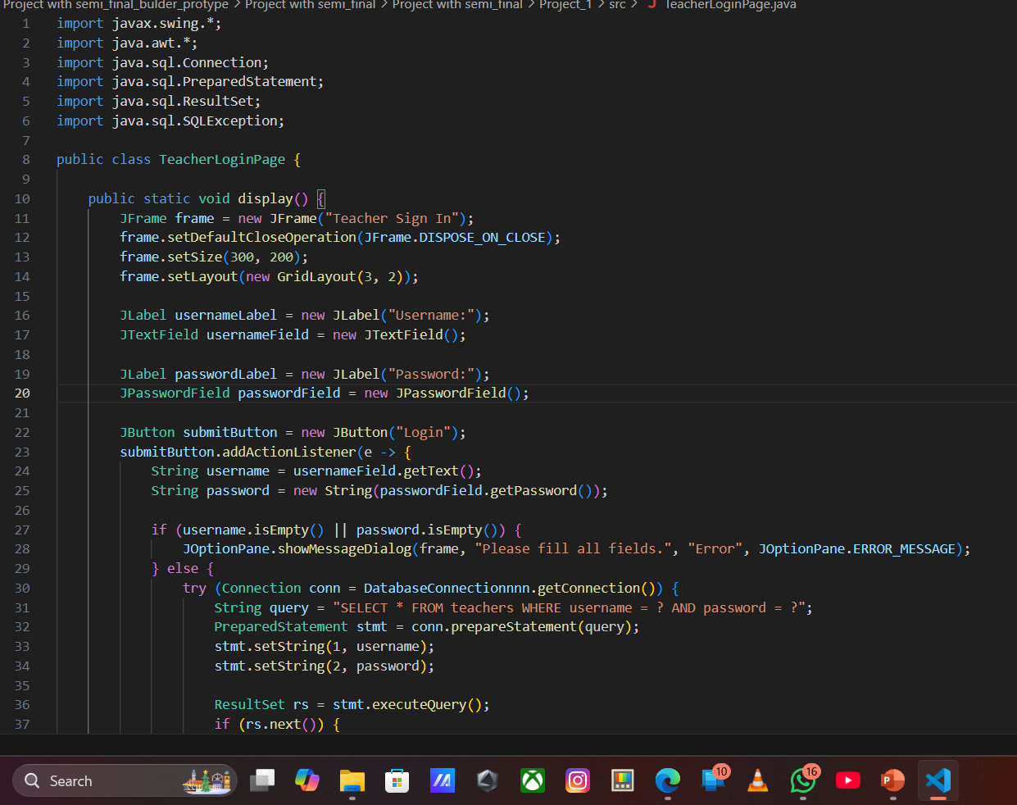
The TeacherLoginPage class is a Java Swing application that allows teachers to log in and manage quiz creation:
Login Page: Teachers enter their username and password to log in. If valid, they proceed to the "Enter Exam Information" page.
Exam Information Page: Teachers enter the exam name and teacher ID, which is stored in the database. Then, the "Set Number of Questions" page opens.
Quiz Count Page: Teachers set the number of questions, and the "Quiz Creation" page is displayed.
Quiz Creation Page: Teachers add questions with four options and the correct one, saving each question to the database.
Database Interaction: The app uses JDBC to insert data into the teachers, exams, and questions tables.

Slide 21
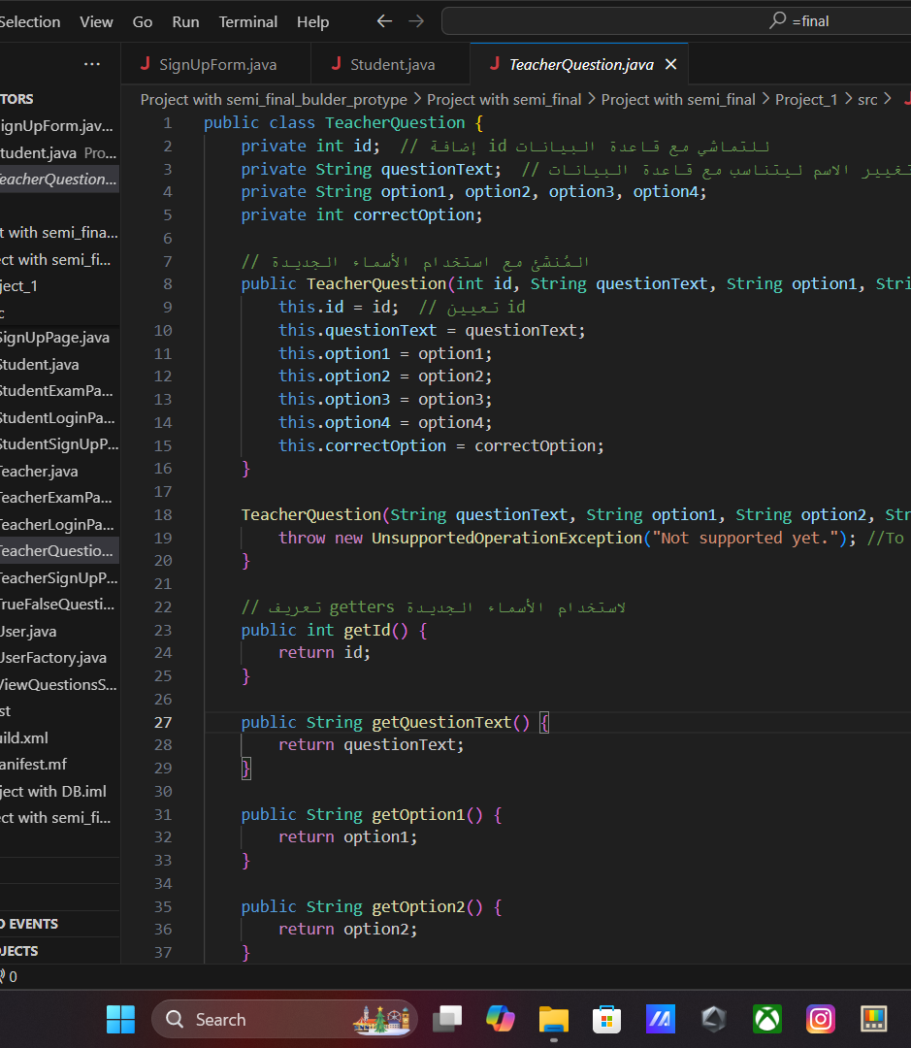
The TeacherQuestion class stores a question's details with:
Fields:
id, questionText, option1, option2, option3, option4, and correctOption.
Constructor:
Initializes all fields, including id.
Getters:
Methods to retrieve the values of the fields.
One constructor is incomplete and throws an exception.

Slide 22
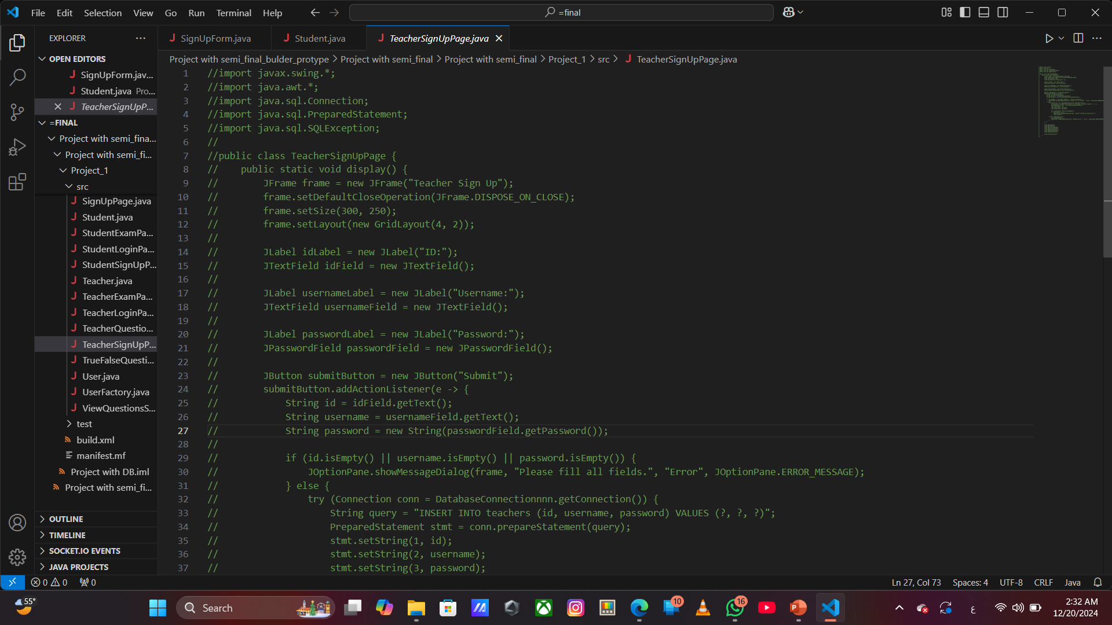
The TeacherSignUpPage class creates a GUI for teacher registration using JFrame. It includes:
Fields:
ID, Username, and Password fields.
Submit Button:
Checks if all fields are filled, then attempts to insert the teacher's data into the database.
Error Handling:
Displays error messages for empty fields or database issues.
Successful Registration:
Displays a success message and closes the window.

Slide 23
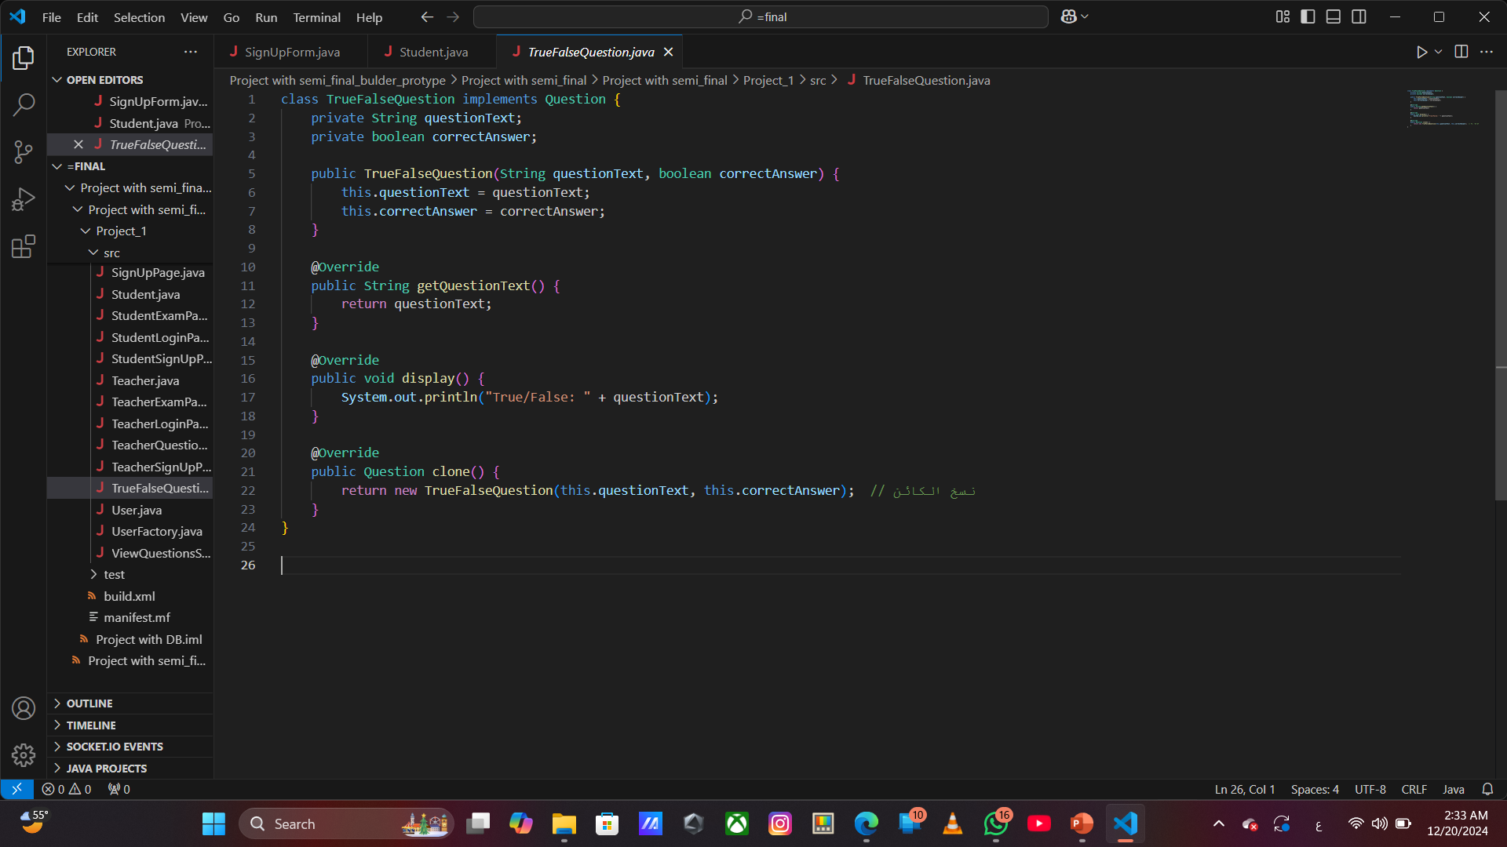
The TrueFalseQuestion class implements the Question interface and provides the following functionalities:
Attributes:
questionText: The text of the question.
correctAnswer: A boolean indicating whether the correct answer is true or false.
Methods:
getQuestionText(): Returns the text of the question.
display(): Displays the question as "True/False" in the console.
clone(): Creates a new instance of TrueFalseQuestion with the same values (deep cloning).
This class is useful for representing true/false type questions in a quiz or exam system.

Slide 24
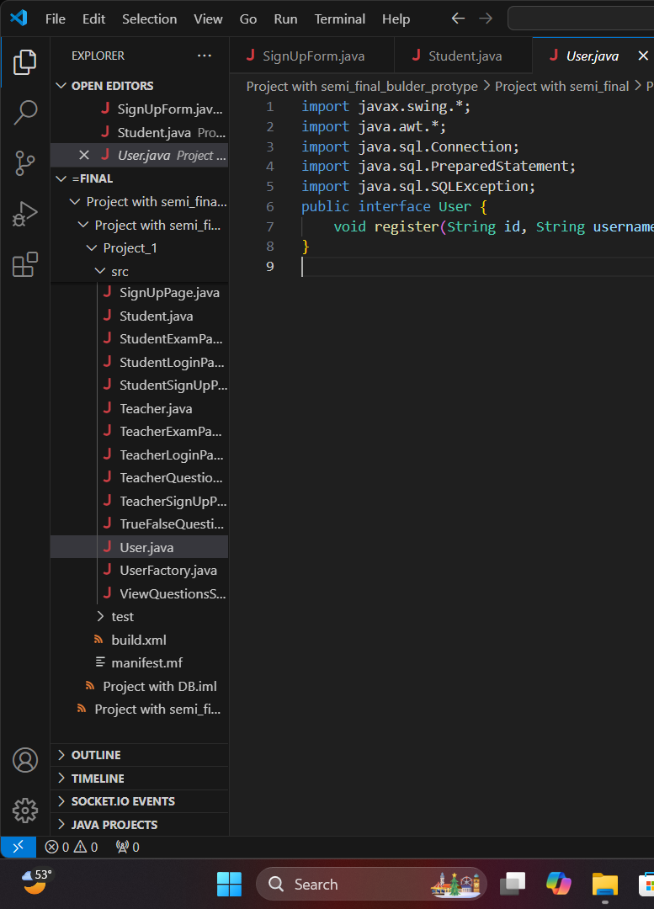
The User interface defines a contract for any class that wants to implement user registration functionality. It includes the following method:
register(String id, String username, String password): This method is intended to be implemented by any class that will handle user registration. It takes the user's id, username, and password as parameters.
To implement this interface, a class would need to define the register method, which can be used to store user data in a database or perform other actions related to user registration.
The interface itself does not provide any implementation but ensures that classes that implement it will include a method for user registration.

Slide 25
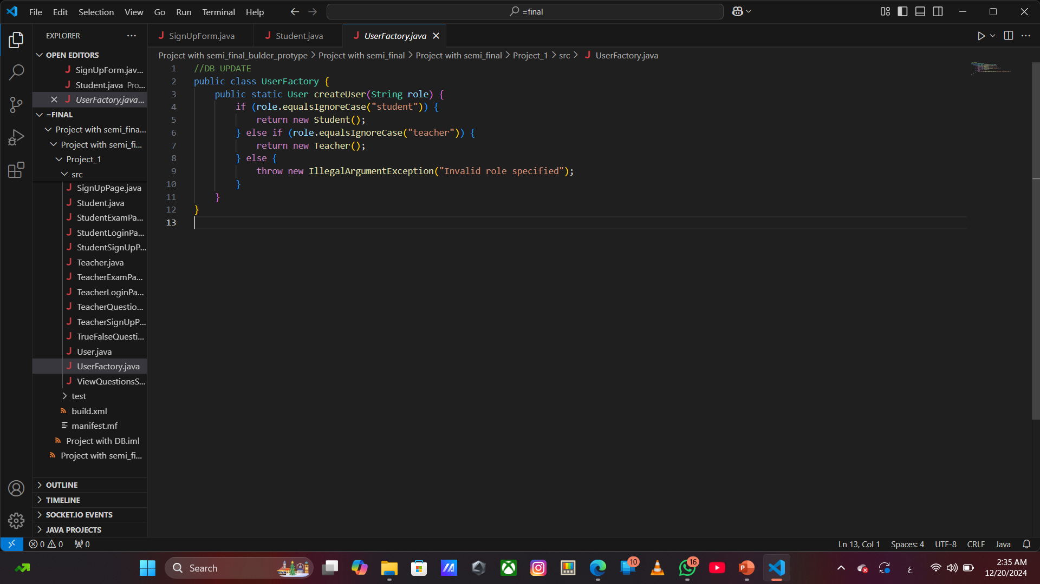
The UserFactory class creates Student or Teacher objects based on the given role. If the role is invalid, it throws an exception. It's a simple implementation of the Factory Method Pattern for decoupling object creation.
Example:
java
User student = UserFactory.createUser("student"); User teacher = UserFactory.createUser("teacher");
This allows easy creation of user objects based on roles.

Slide 26
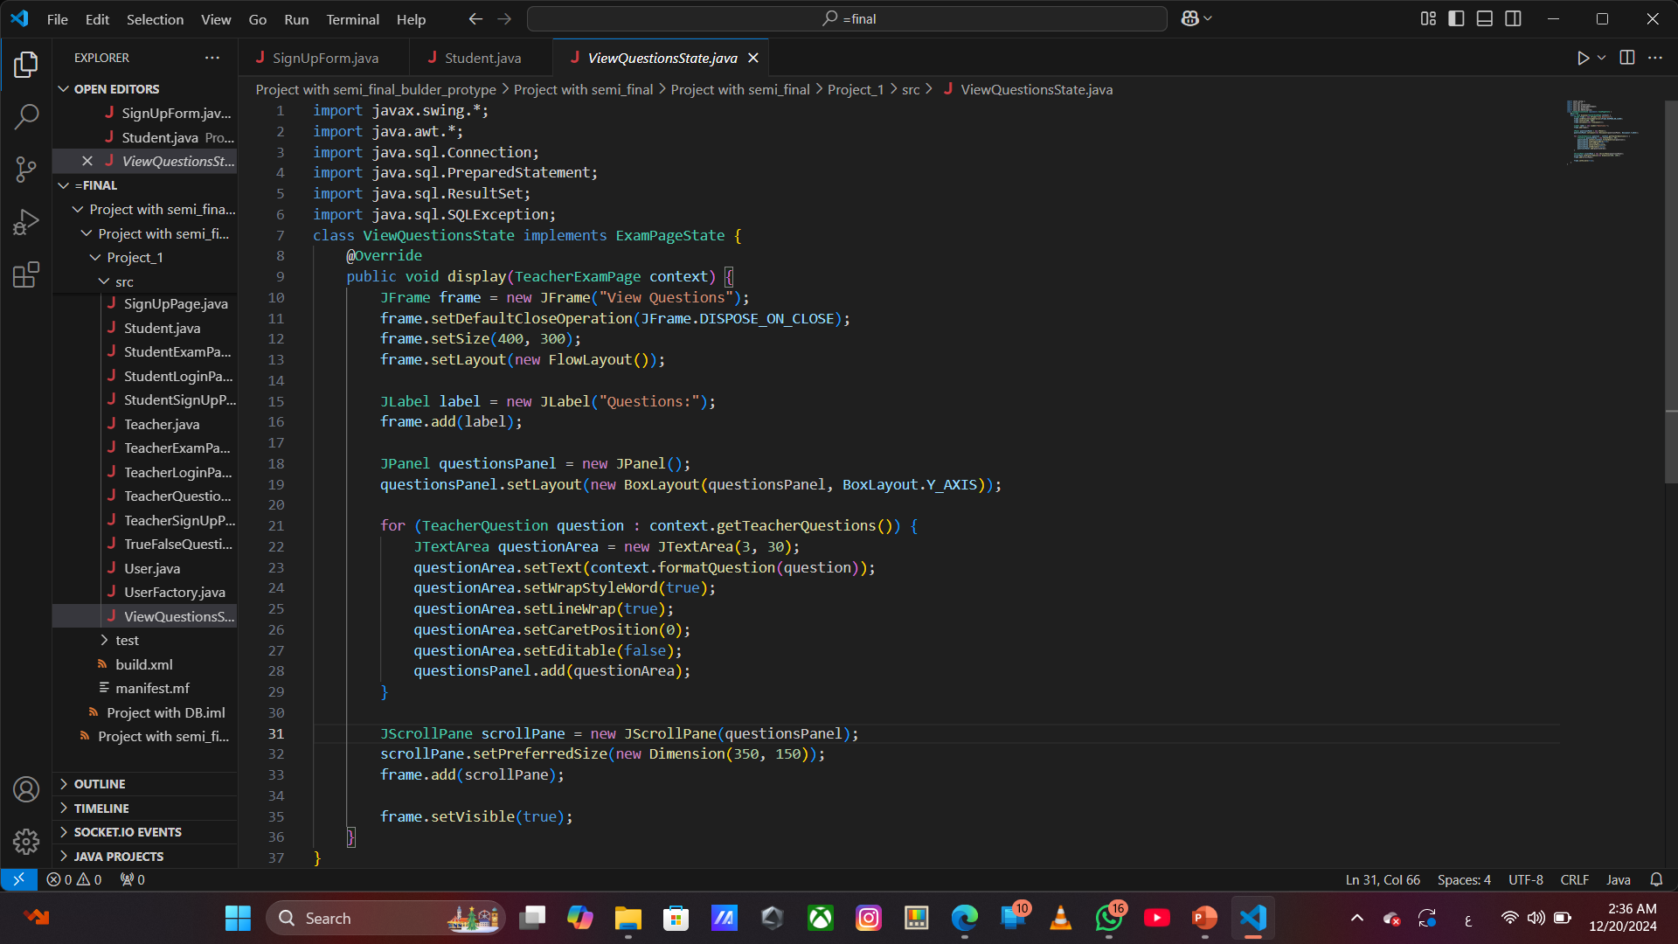
The ViewQuestionsState class implements the ExamPageState interface. It is responsible for displaying the questions in a TeacherExamPage context.
Key Points:
It creates a JFrame to display questions.
It uses JTextArea components to show the questions in a scrollable panel.
The questions are retrieved from the TeacherExamPage context and displayed in a vertical layout.
The textArea.setEditable(false) ensures the questions cannot be edited.
Summary:
This class is part of a state pattern implementation to allow switching between different states (such as viewing or adding questions) in the TeacherExamPage. The questions are shown in a scrollable panel for easy viewing.

